Slide 1

Google My Business (GMB) Optimization for Local SEO

Slide 2

ABOUT US
About
Name: Aryan Phadnis
Course: Digital Marketing
Project: Google My Business (GMB) Optimization for Local SEO

Slide 3

Introduction
• In today’s digital era, most customers search online before purchasing any product or visiting a store. • Search engines help users find nearby businesses quickly and easily. • For local businesses, having a strong online presence is very important to attract customers. • Google My Business allows businesses to appear on Google search results and Google Maps. • With proper optimization, businesses can improve their local search visibility and reach more potential customers.

Slide 4
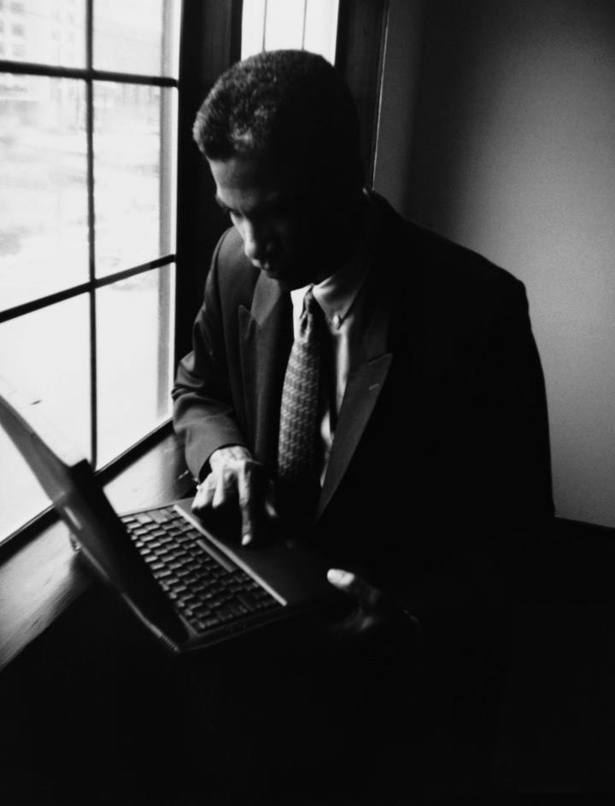
What is Google My Business
• Google My Business is a free tool by Google. • Helps businesses manage their online presence. • Shows business details on search results.

Slide 5

What is Local SEO
• Local SEO improves business visibility in local search results. • Helps nearby customers find local businesses. • Important for small and local stores.
Your business details should be consistent across all platforms like websites, directories, and social media

Slide 6
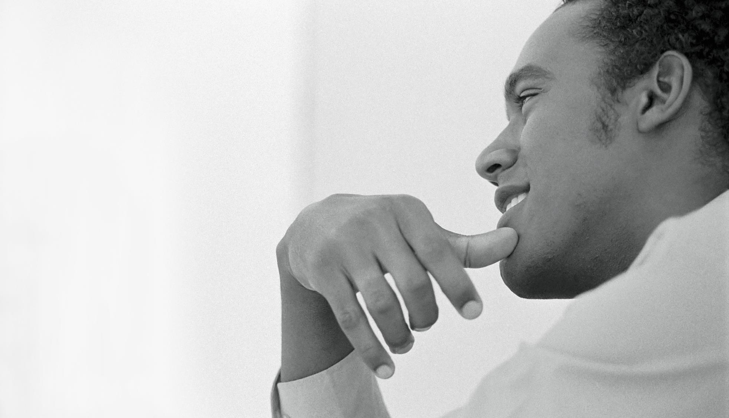
Importance of Local SEO
• Attracts local customers. • Increases store visits. • Improves online visibility.
Benefits

Slide 7

Role of Google Maps
Business location appears on Google Map.
Customers can easily navigate to the shop.
Improves local search results.

Slide 8

Services & Products
List your services or products
SEO Audit
Social Media Management
Paid Ads
Website Optimization
Optional: Add price range

Slide 9

Attributes
,
.
.
Wheelchair accessible”
Gives extra info to customers
Women-led
Online Appointments”

Slide 10

Reviews& Ratings
Encourage satisfied customers to leave reviews
Reply professionally to all reviews
Improves trust & local SEO ranking
summary

Slide 11

Conclusion
GBM is essential for local business visibility
Complete info + photos + reviews + posts = higher engagement
Regular updates & monitoring are key for success

Slide 12

Thankyou.........

